Slide 1


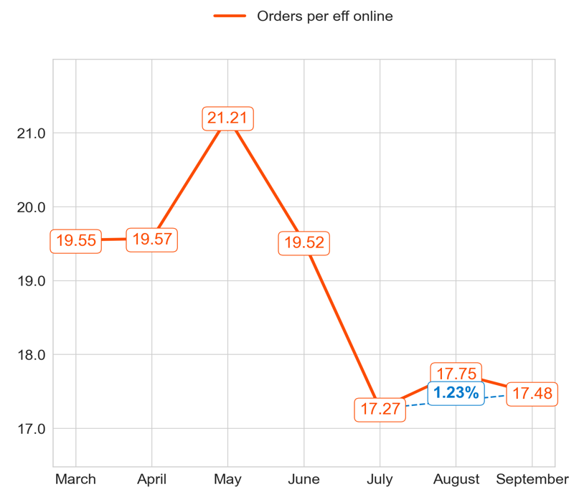
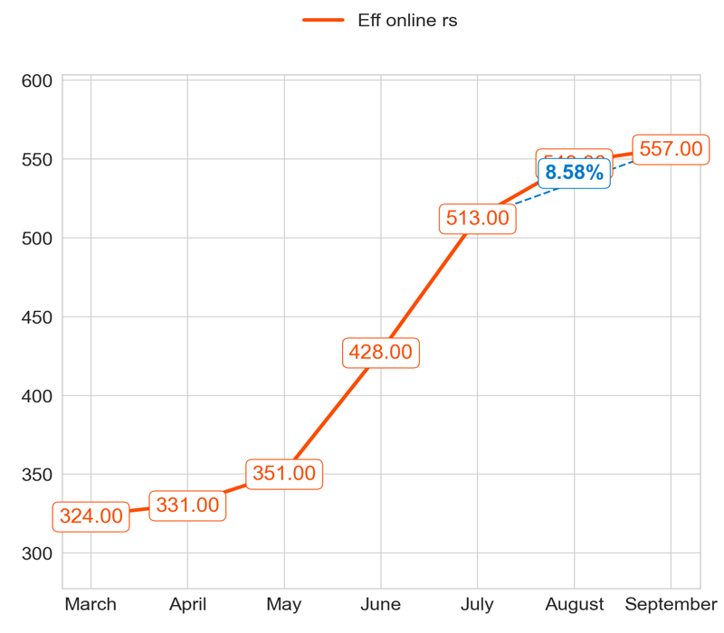
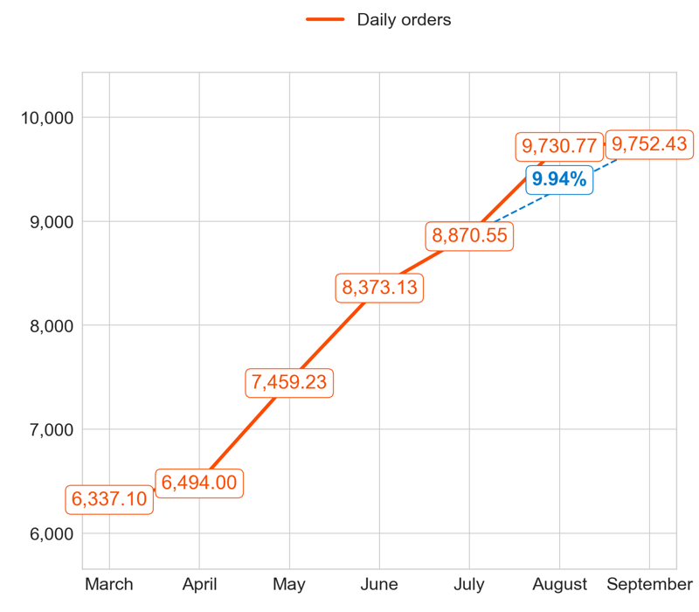
PERFORMANCE
Action Title
Priority 1 -
Comments
Highest: 21.21, Lowest: 17.27
Mean of the last 4 months: 18.80
Highest: 557.00, Lowest: 324.00
Mean of the last 4 months: 454.67
Highest: 9,752.43, Lowest: 6,337.10
Mean of the last 4 months: 8,446.69

Slide 2
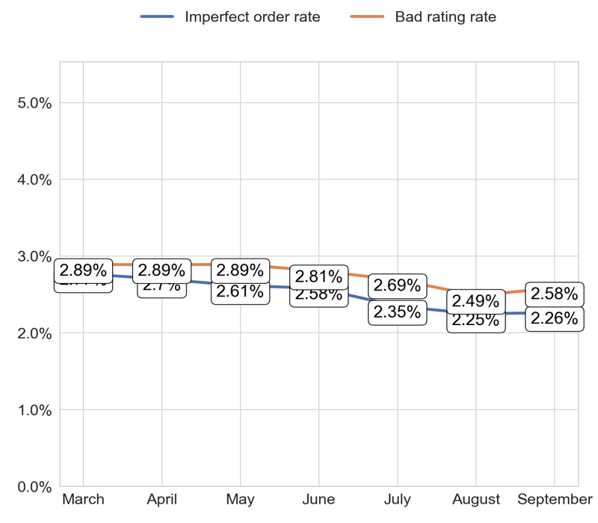
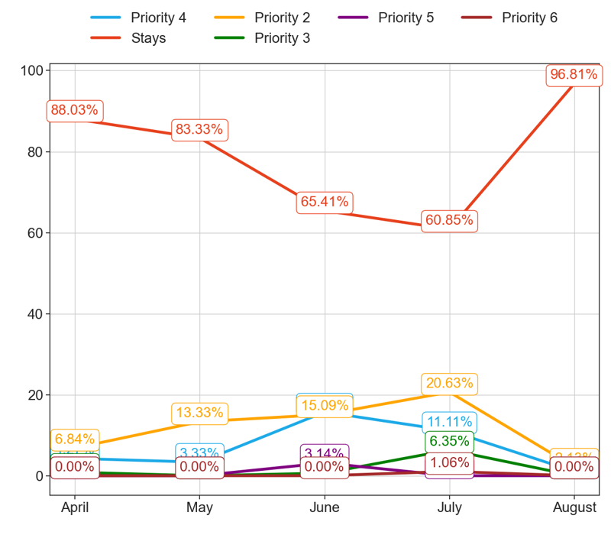
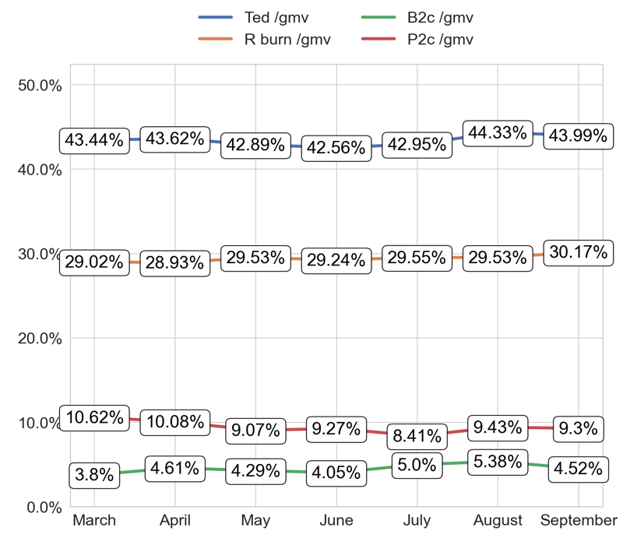
SERVICE
Action Title
Priority 1 -
Comments
Imperfect order rate average in the last 4 months: 2.5 % and the percentage change between the last 2 months: 0.79%.
Bad rating rate average in the last 4 months: 2.75 % and the percentage change between the last 2 months: 3.48%.
No comments
No comments

Slide 3
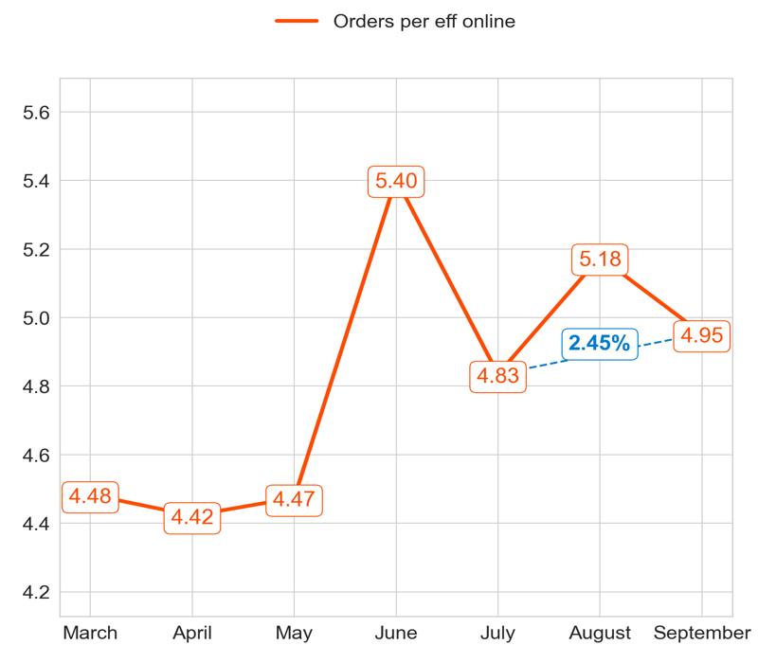
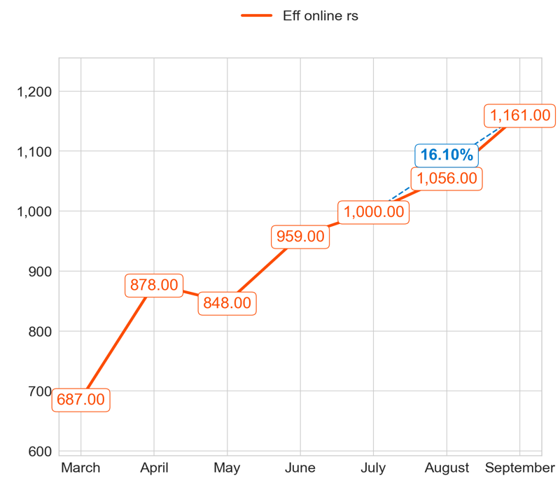
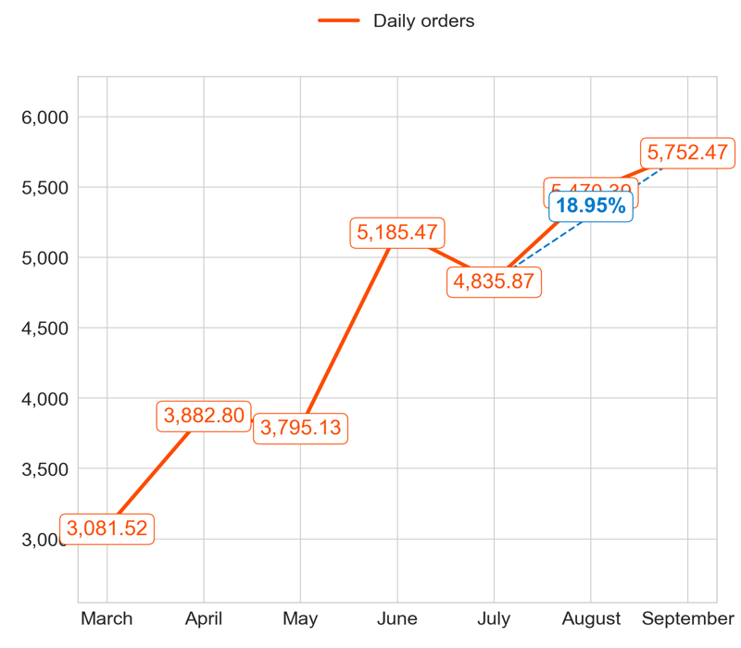
PERFORMANCE
Action Title
Priority 2 -
Comments
Highest: 5.40, Lowest: 4.42
Mean of the last 4 months: 4.88
Highest: 1,161.00, Lowest: 687.00
Mean of the last 4 months: 983.67
Highest: 5,752.47, Lowest: 3,081.52
Mean of the last 4 months: 4,820.35

Slide 4
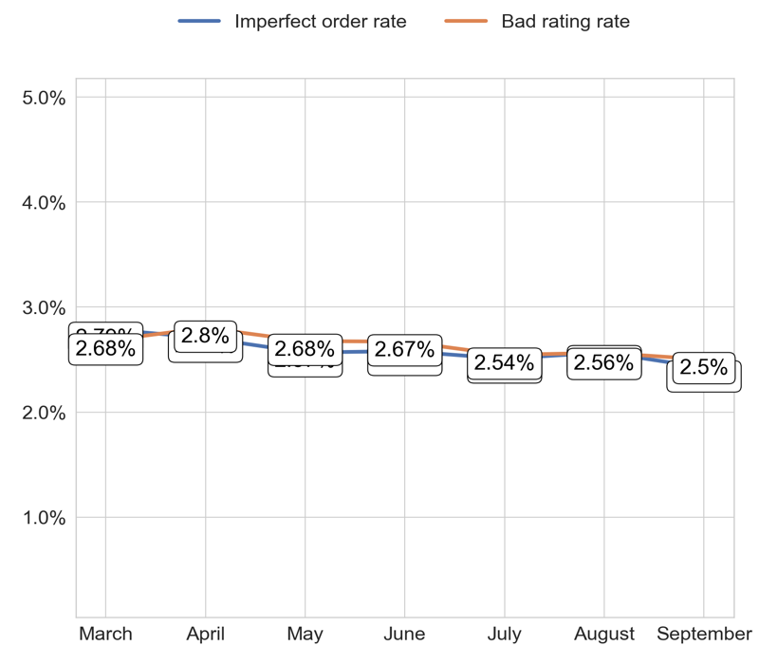
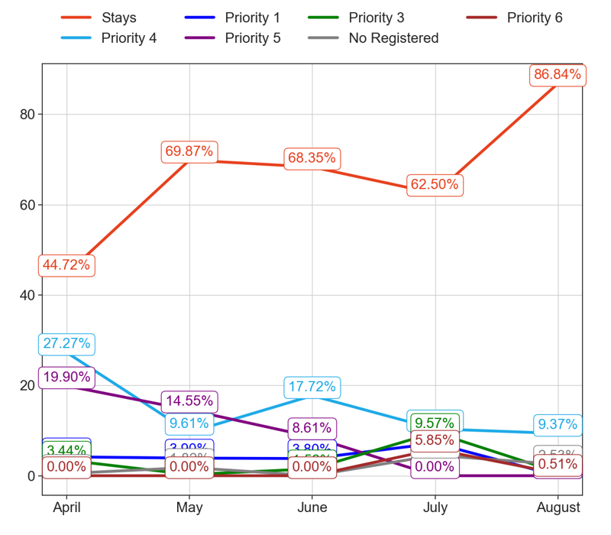
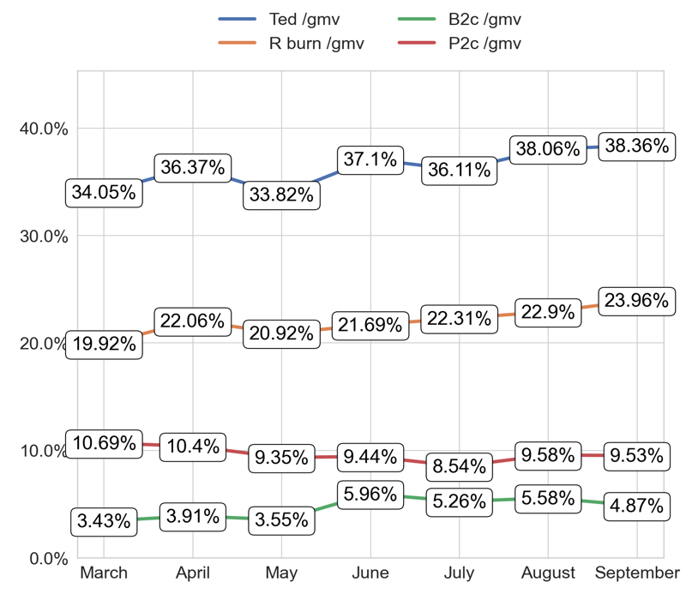
SERVICE
Action Title
Priority 2 -
Comments
Imperfect order rate average in the last 4 months: 2.59 % and the percentage change between the last 2 months: -5.8%.
Bad rating rate average in the last 4 months: 2.63 % and the percentage change between the last 2 months: -2.48%.
No comments
No comments

Slide 5
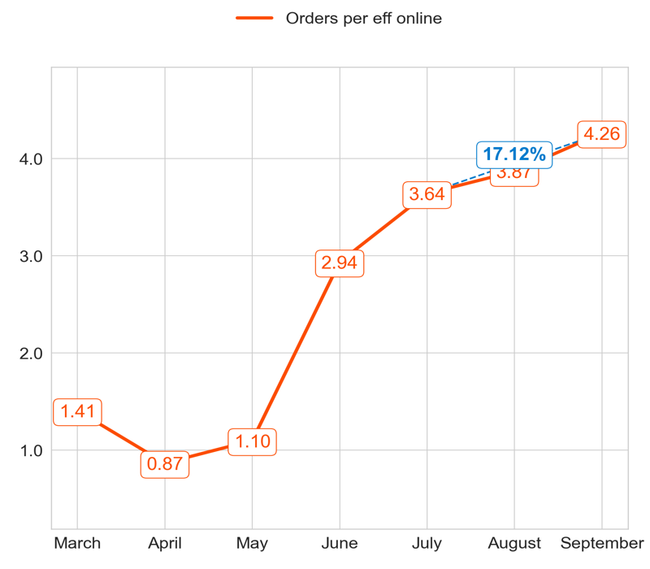
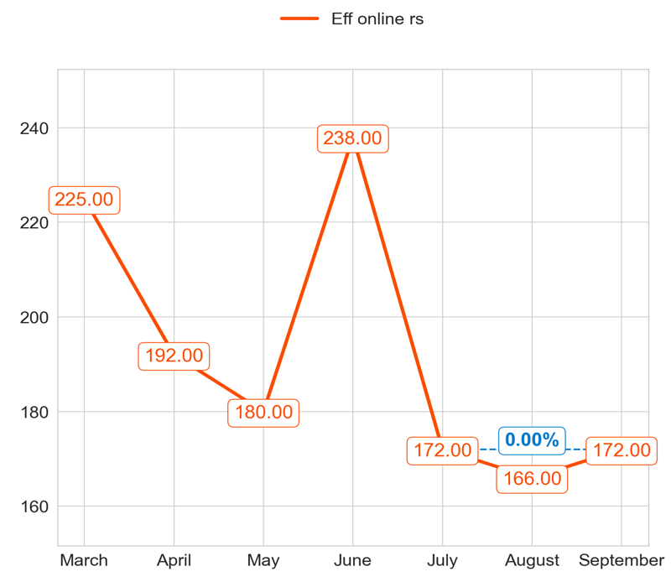
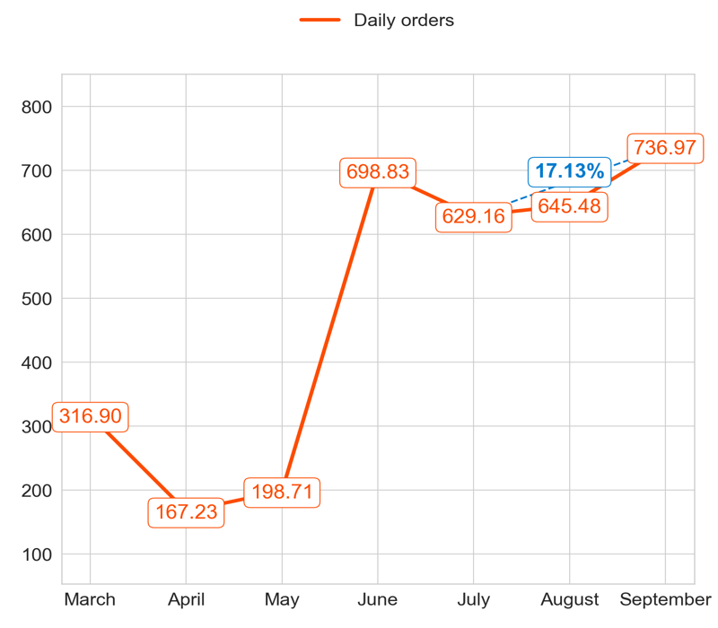
PERFORMANCE
Action Title
Priority 3 -
Comments
Highest: 4.26, Lowest: 0.87
Mean of the last 4 months: 2.78
Highest: 238.00, Lowest: 166.00
Mean of the last 4 months: 186.67
Highest: 736.97, Lowest: 167.23
Mean of the last 4 months: 512.73

Slide 6
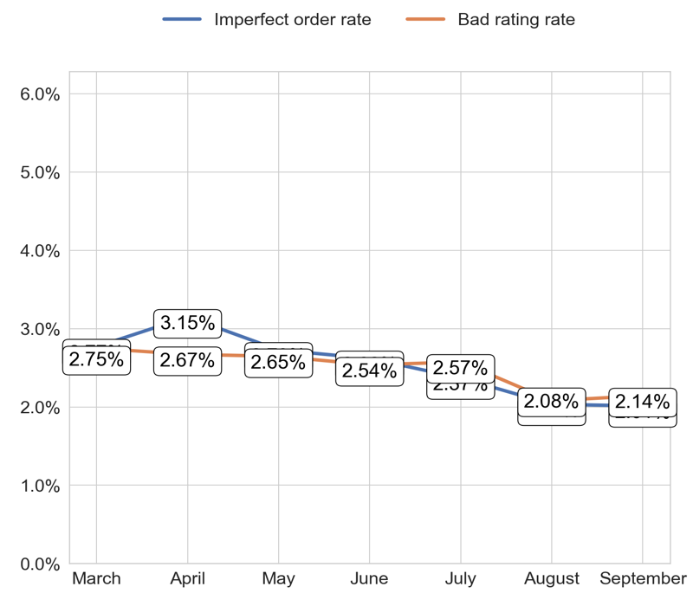
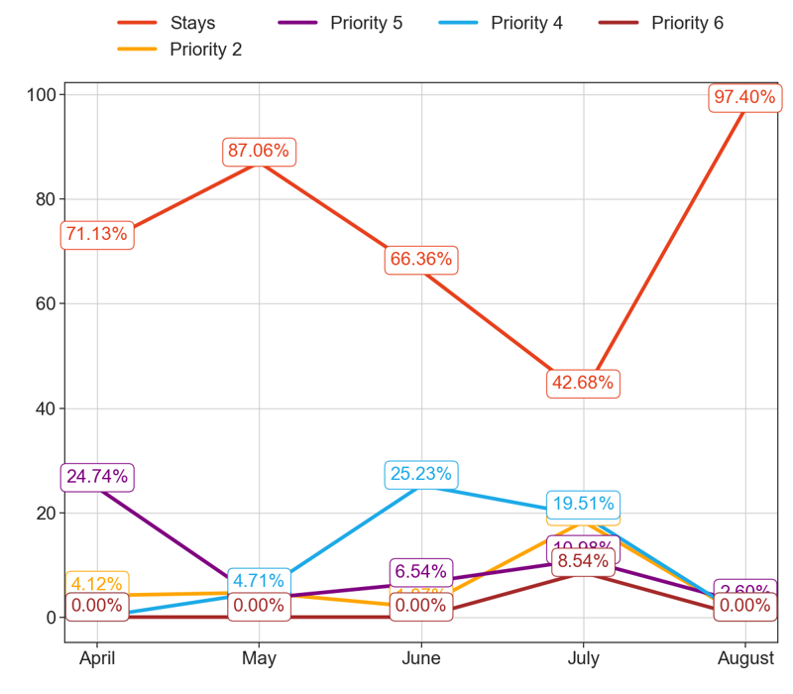
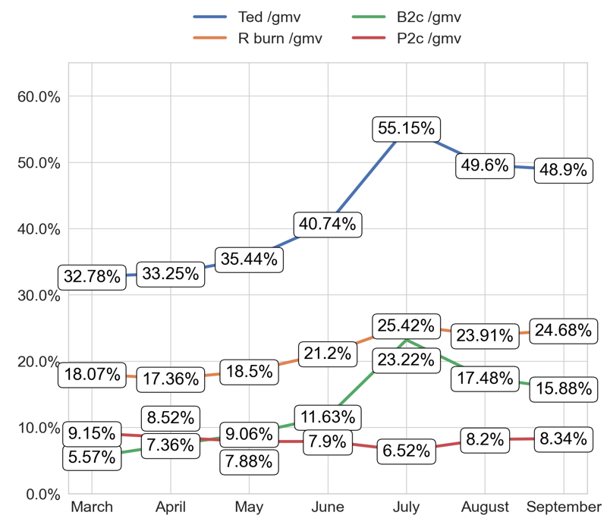
SERVICE
Action Title
Priority 3 -
Comments
Imperfect order rate average in the last 4 months: 2.53 % and the percentage change between the last 2 months: -0.9%.
Bad rating rate average in the last 4 months: 2.49 % and the percentage change between the last 2 months: 2.52%.
No comments
No comments

Slide 7
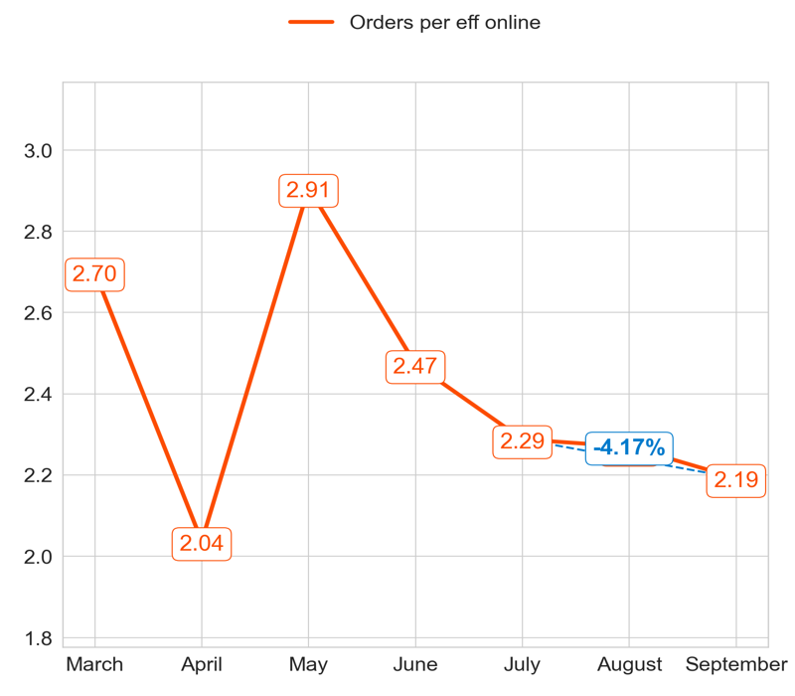
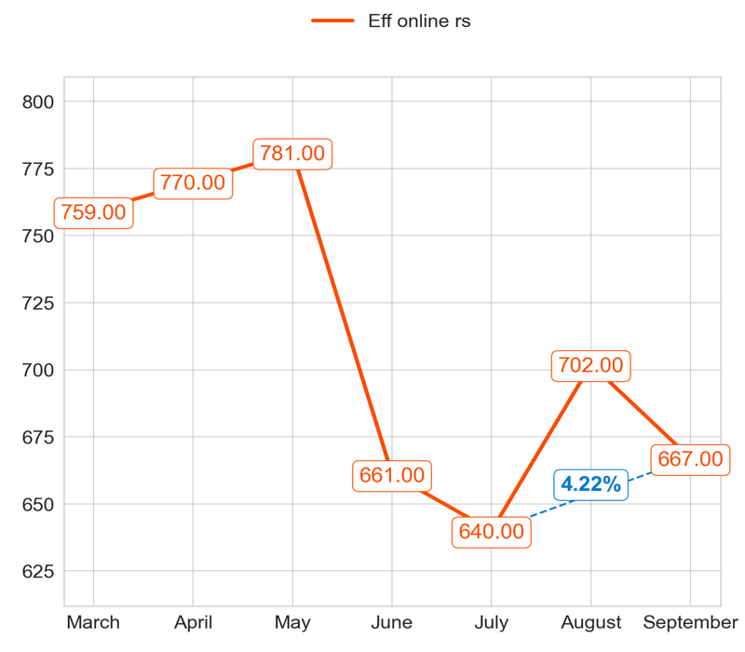
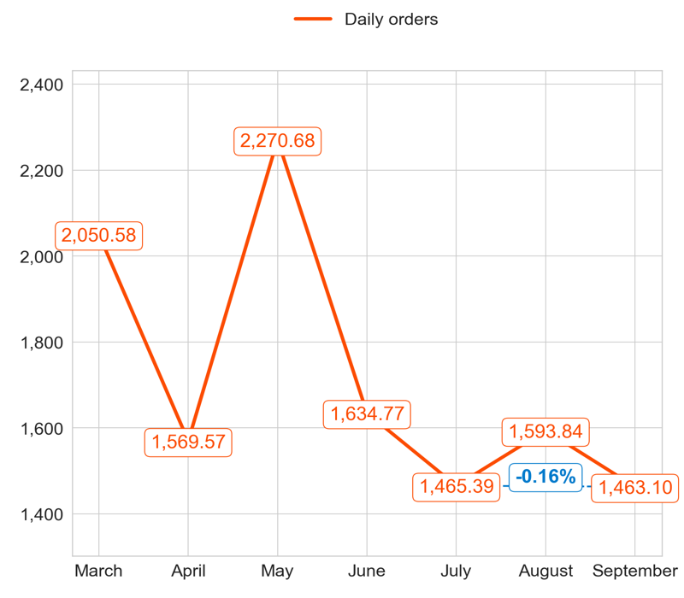
PERFORMANCE
Action Title
Priority 4 -
Comments
Highest: 2.91, Lowest: 2.04
Mean of the last 4 months: 2.36
Highest: 781.00, Lowest: 640.00
Mean of the last 4 months: 703.50
Highest: 2,270.68, Lowest: 1,463.10
Mean of the last 4 months: 1,666.22

Slide 8
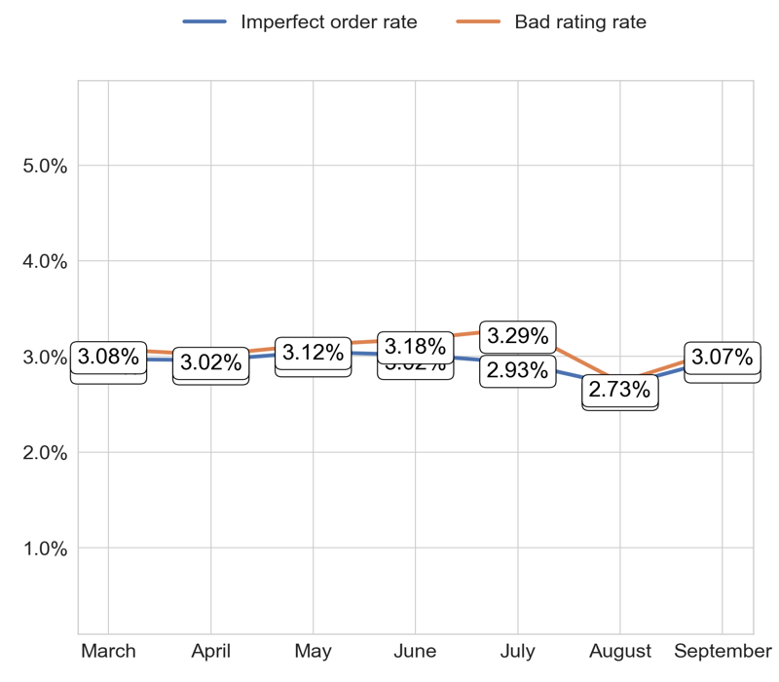
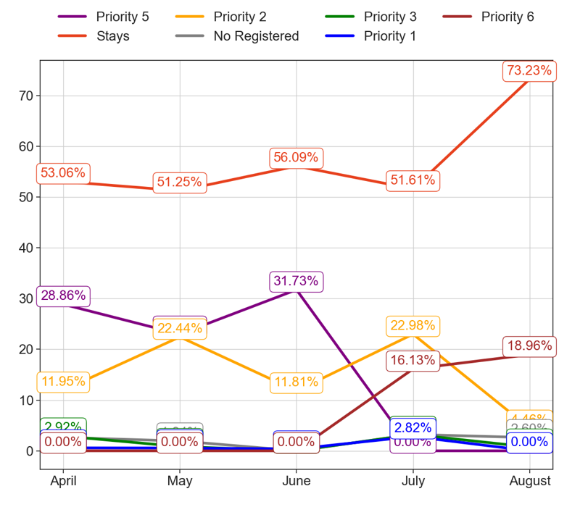
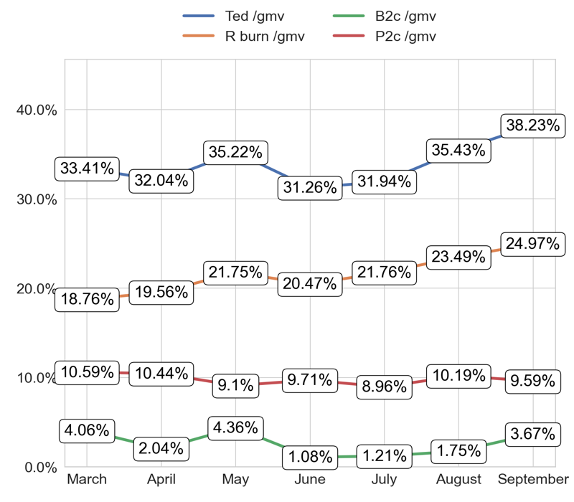
SERVICE
Action Title
Priority 4 -
Comments
Imperfect order rate average in the last 4 months: 2.94 % and the percentage change between the last 2 months: 9.83%.
Bad rating rate average in the last 4 months: 3.07 % and the percentage change between the last 2 months: 10.36%.
No comments
No comments

Slide 9
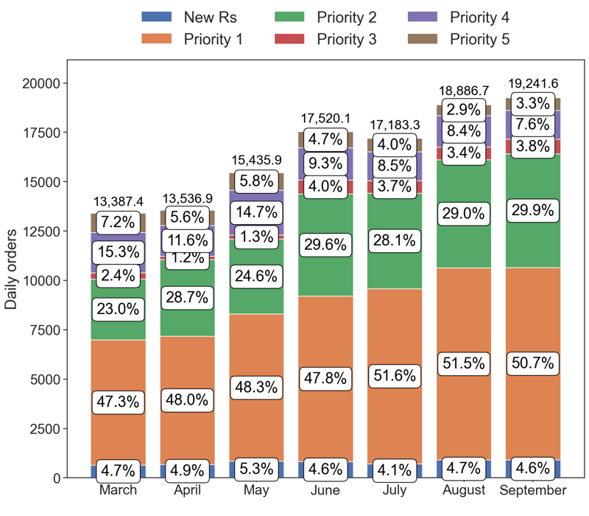
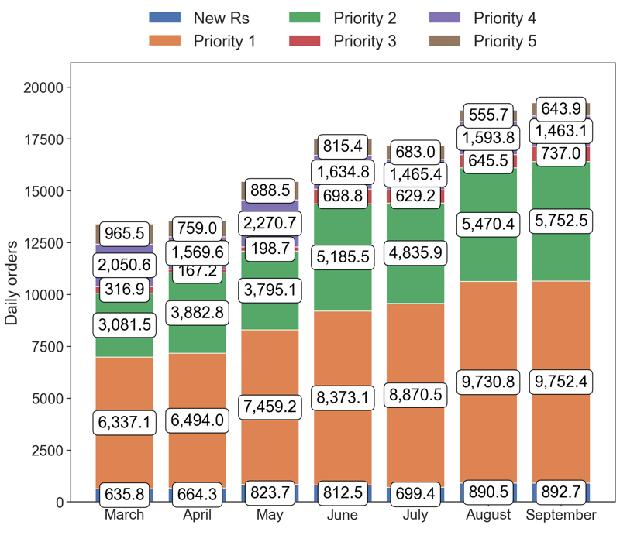
PERFORMANCE
Action Title
Country overview -
Comments
Last Month Data:
New Rs: 892.67, Priority 1: 9,752.43, Priority 2: 5,752.47, Priority 3: 736.97, Priority 4: 1,463.10, Priority 5: 643.93
Last Month percentages:
New Rs: 4.64%, Priority 1: 50.68%, Priority 2: 29.9%, Priority 3: 3.83%, Priority 4: 7.6%, Priority 5: 3.35%

Slide 10
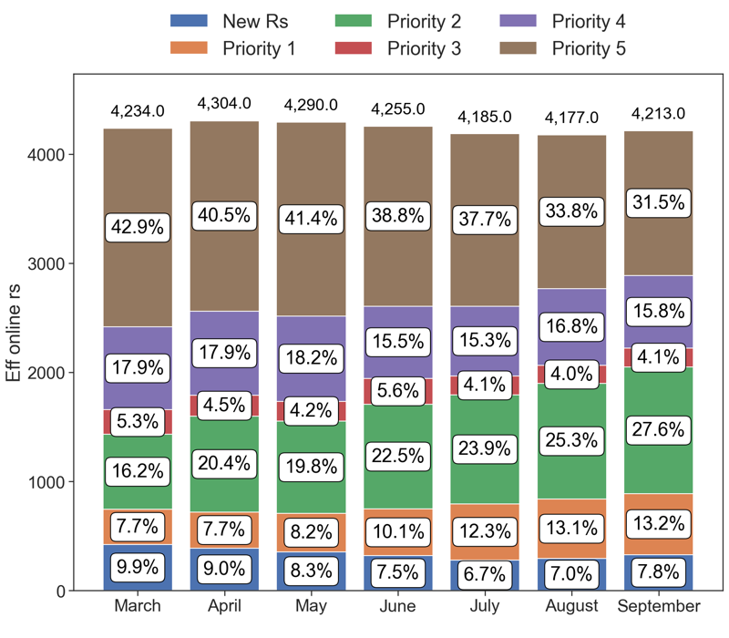
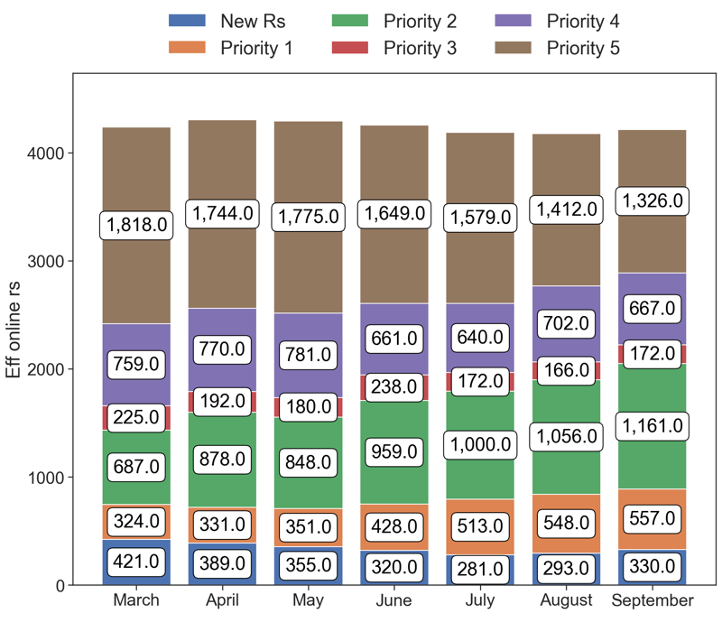
PERFORMANCE
Action Title
Country overview -
Comments
Last Month Data:
New Rs: 330.00, Priority 1: 557.00, Priority 2: 1,161.00, Priority 3: 172.00, Priority 4: 667.00, Priority 5: 1,326.00
Last Month percentages:
New Rs: 7.83%, Priority 1: 13.22%, Priority 2: 27.56%, Priority 3: 4.08%, Priority 4: 15.83%, Priority 5: 31.47%

Slide 11

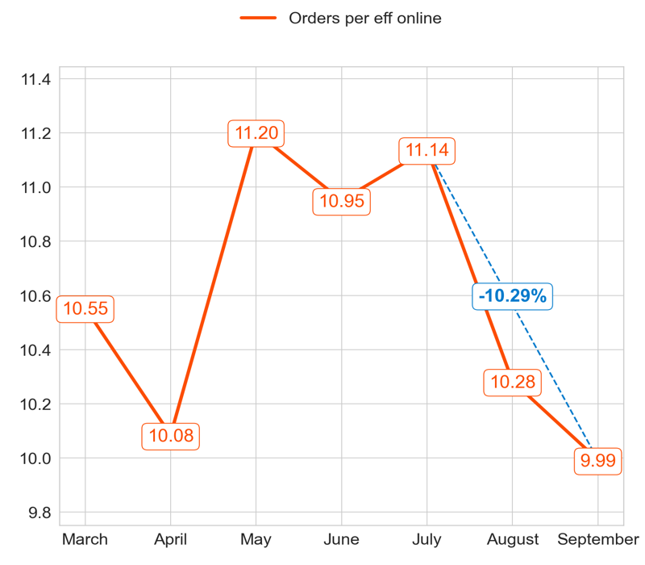
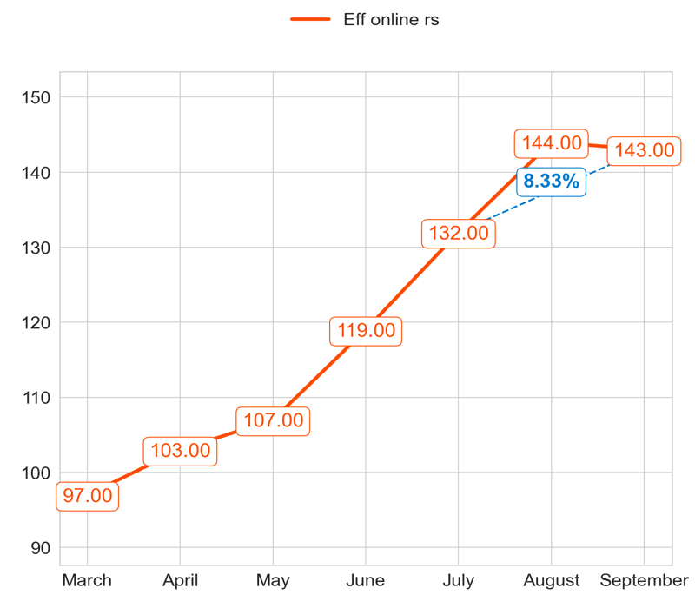
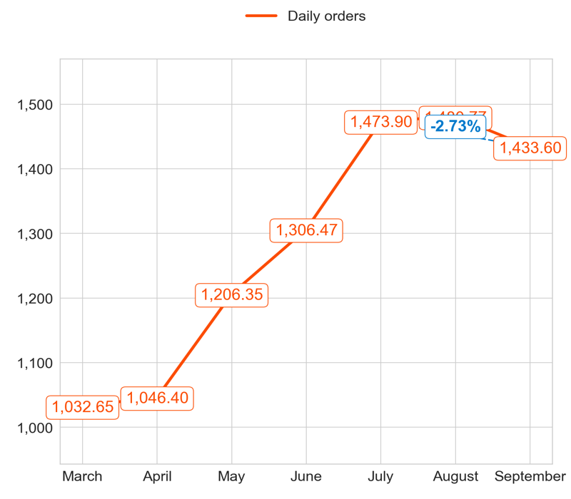
PERFORMANCE
Action Title
Priority 1 -
Comments
Highest: 11.20, Lowest: 9.99
Mean of the last 4 months: 10.61
Highest: 144.00, Lowest: 97.00
Mean of the last 4 months: 124.67
Highest: 1,480.77, Lowest: 1,032.65
Mean of the last 4 months: 1,324.58

Slide 12
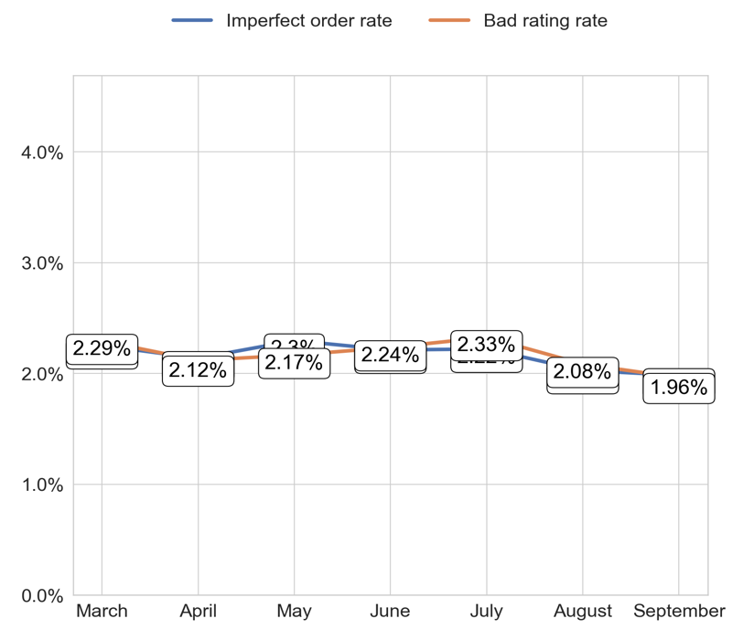
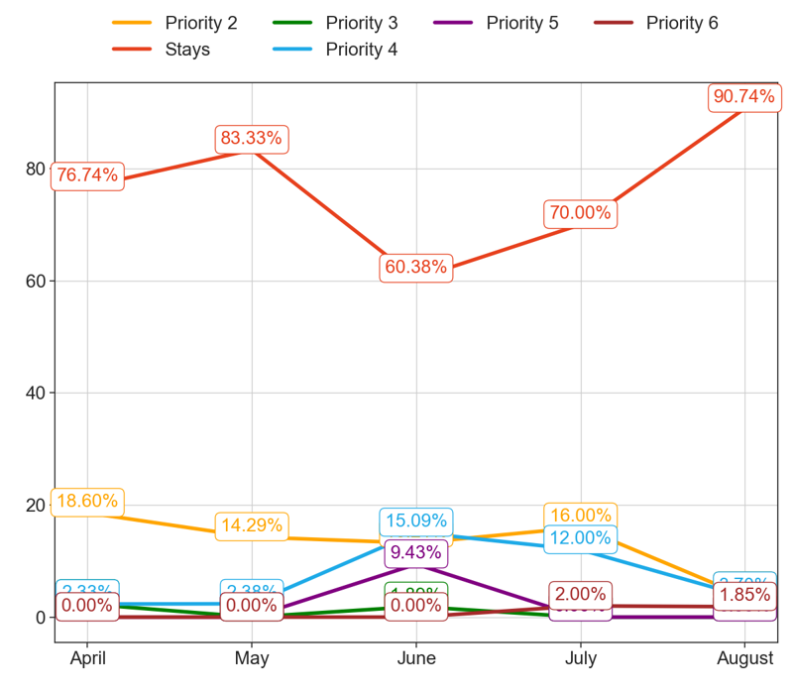
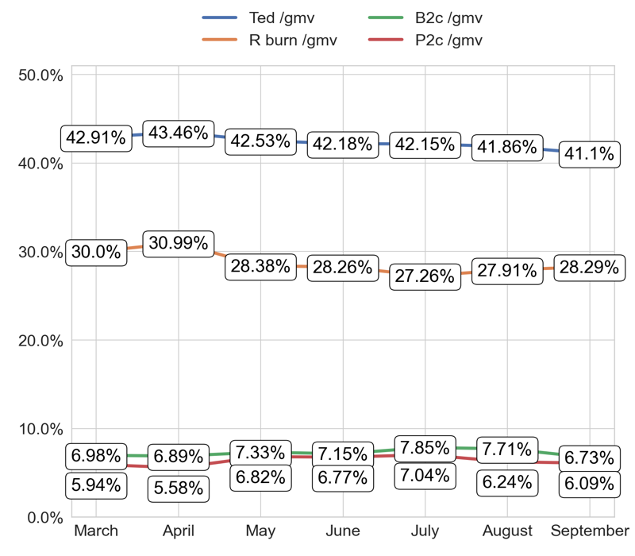
SERVICE
Action Title
Priority 1 -
Comments
Imperfect order rate average in the last 4 months: 2.16 % and the percentage change between the last 2 months: -2.02%.
Bad rating rate average in the last 4 months: 2.17 % and the percentage change between the last 2 months: -5.26%.
No comments
No comments

Slide 13
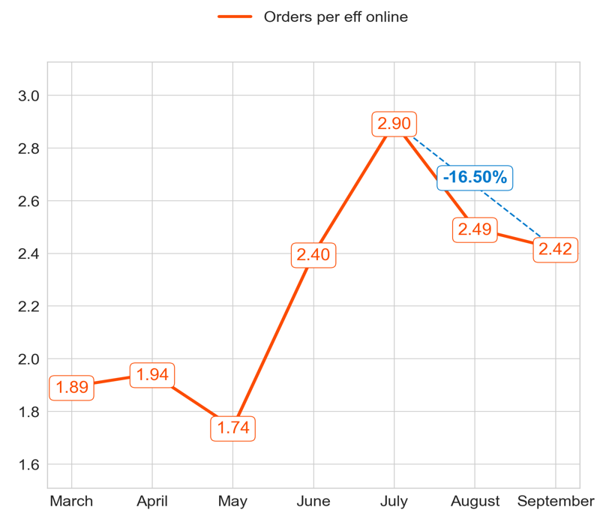
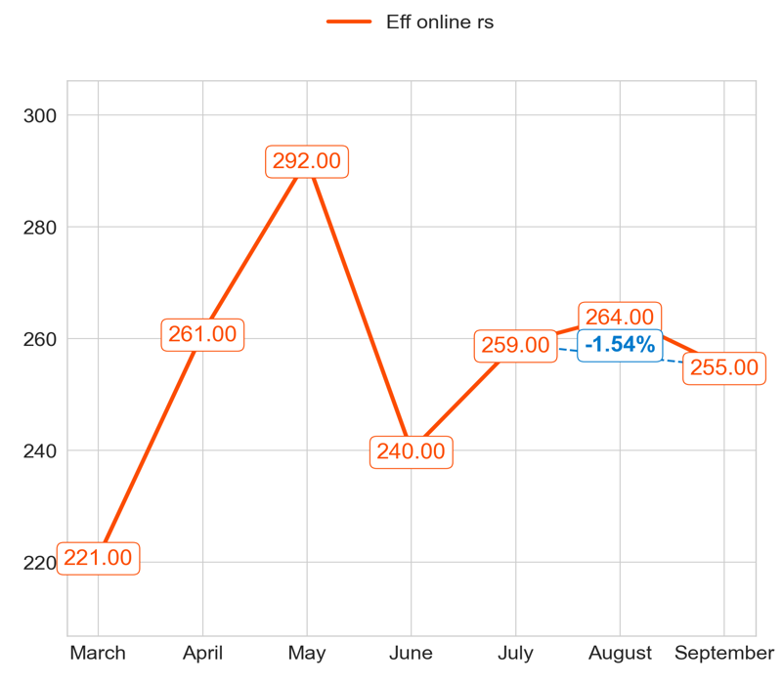
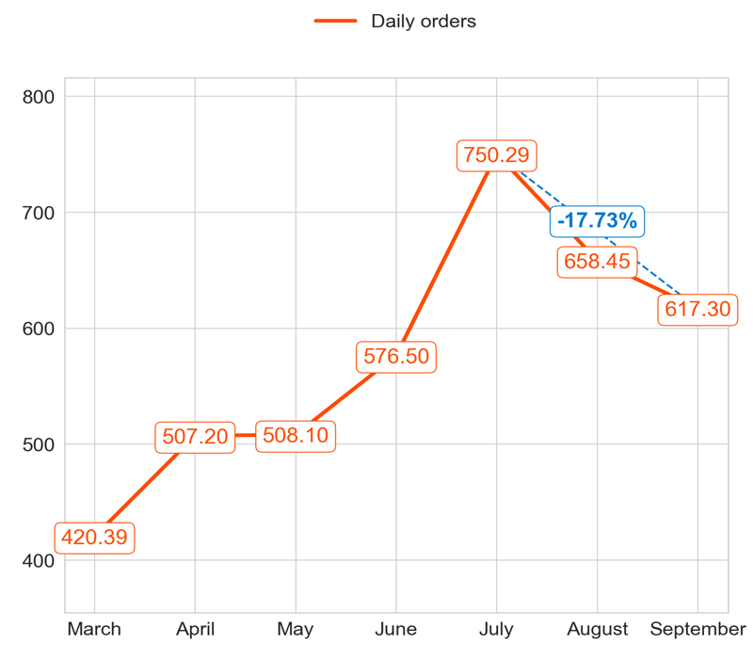
PERFORMANCE
Action Title
Priority 2 -
Comments
Highest: 2.90, Lowest: 1.74
Mean of the last 4 months: 2.31
Highest: 292.00, Lowest: 221.00
Mean of the last 4 months: 261.83
Highest: 750.29, Lowest: 420.39
Mean of the last 4 months: 602.97

Slide 14
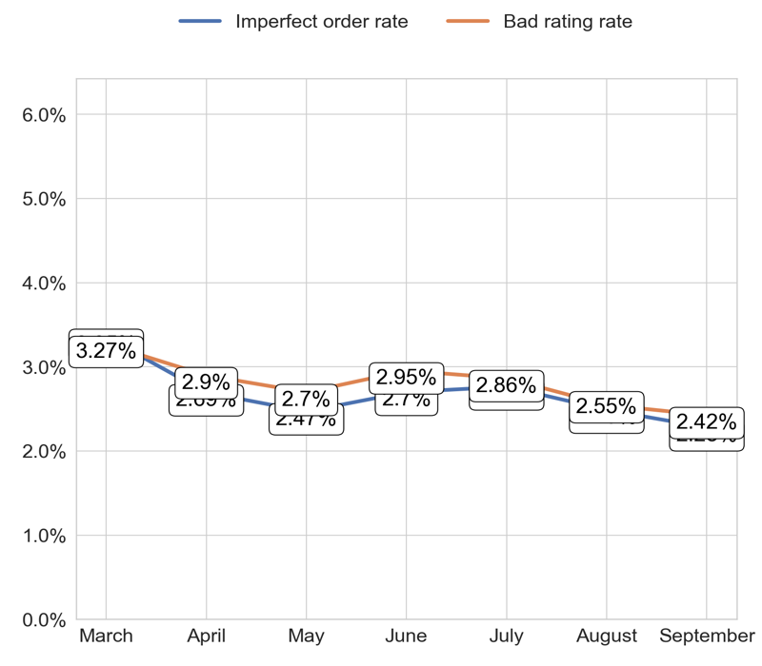
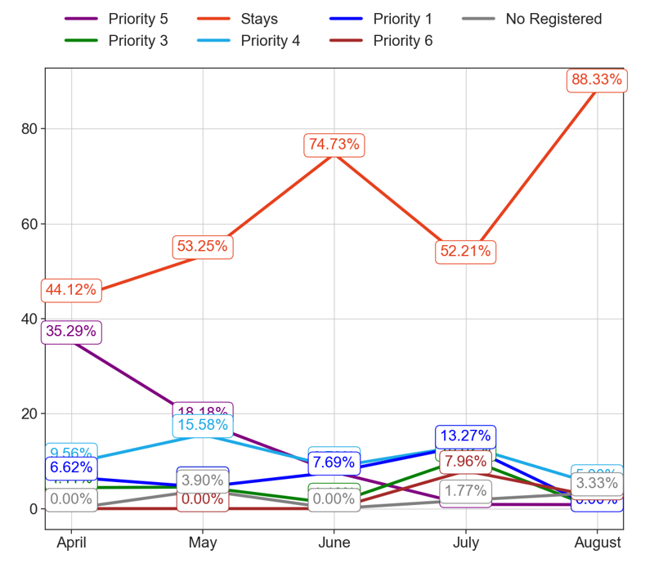
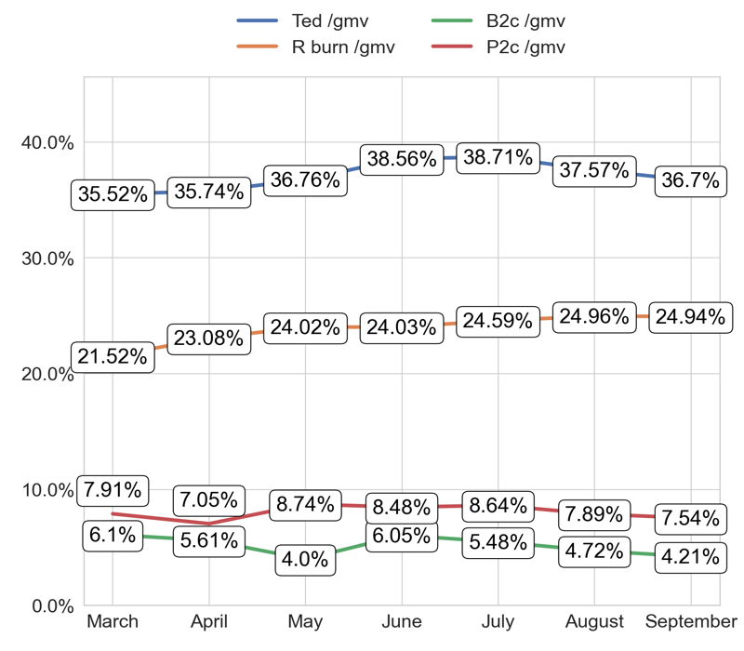
SERVICE
Action Title
Priority 2 -
Comments
Imperfect order rate average in the last 4 months: 2.68 % and the percentage change between the last 2 months: -7.6%.
Bad rating rate average in the last 4 months: 2.81 % and the percentage change between the last 2 months: -4.3%.
No comments
No comments

Slide 15
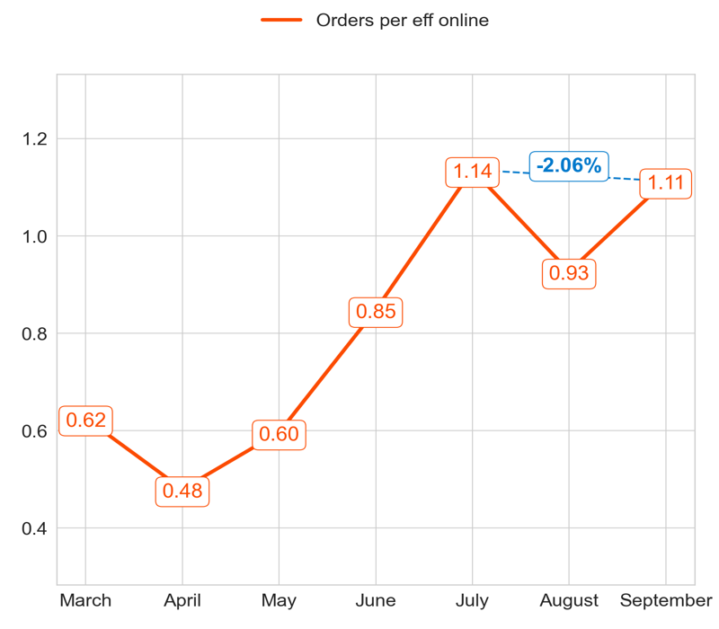
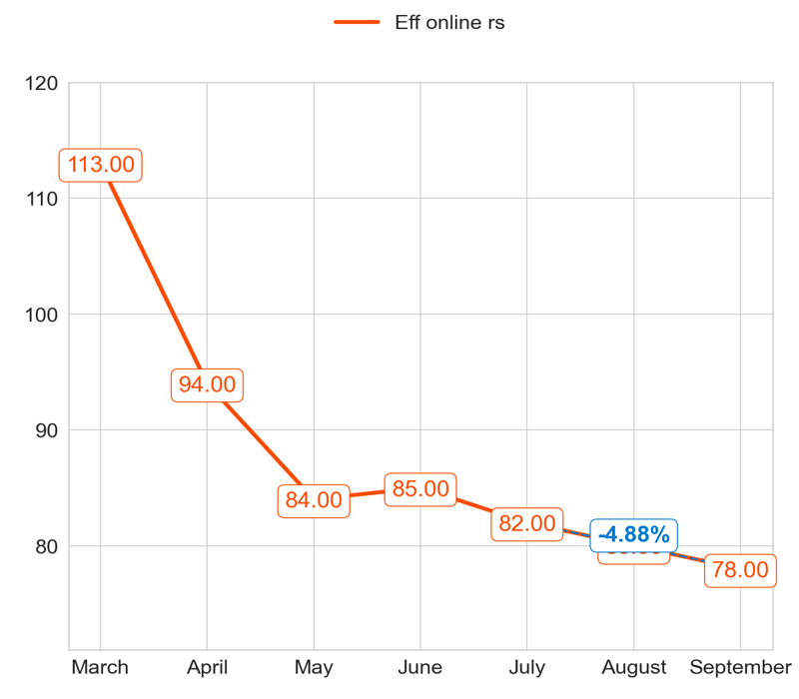
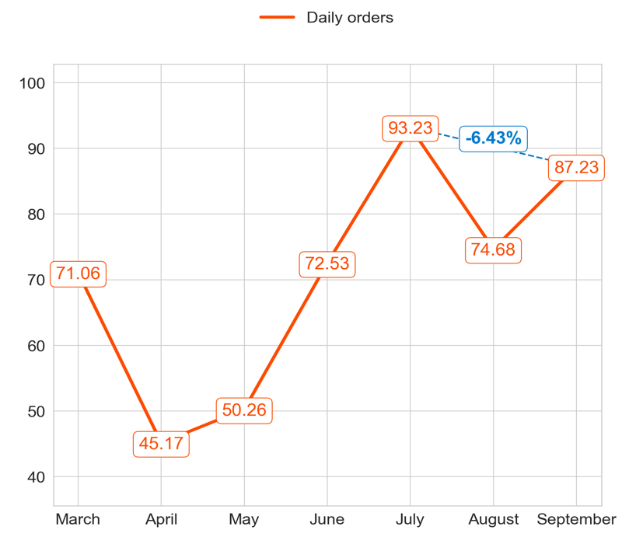
PERFORMANCE
Action Title
Priority 3 -
Comments
Highest: 1.14, Lowest: 0.48
Mean of the last 4 months: 0.85
Highest: 113.00, Lowest: 78.00
Mean of the last 4 months: 83.83
Highest: 93.23, Lowest: 45.17
Mean of the last 4 months: 70.52

Slide 16
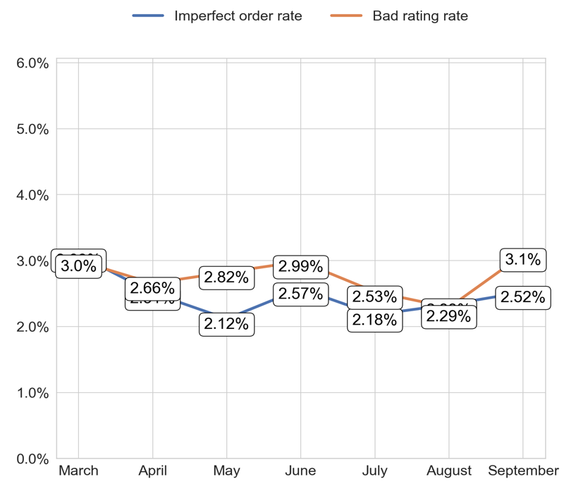
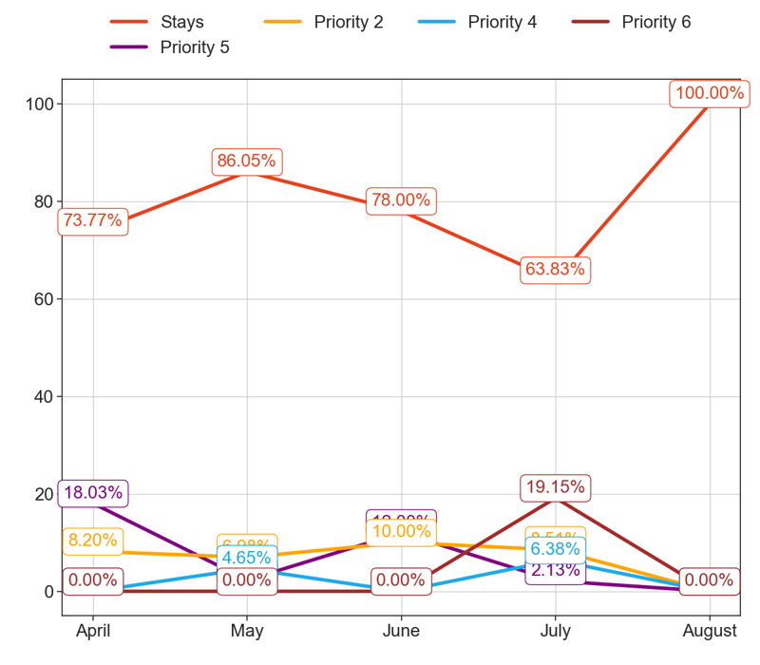
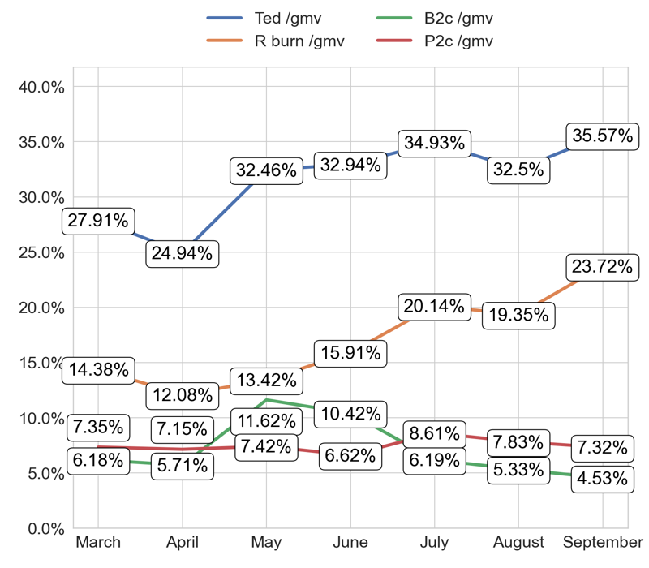
SERVICE
Action Title
Priority 3 -
Comments
Imperfect order rate average in the last 4 months: 2.47 % and the percentage change between the last 2 months: 8.69%.
Bad rating rate average in the last 4 months: 2.77 % and the percentage change between the last 2 months: 31.9%.
No comments
No comments

Slide 17
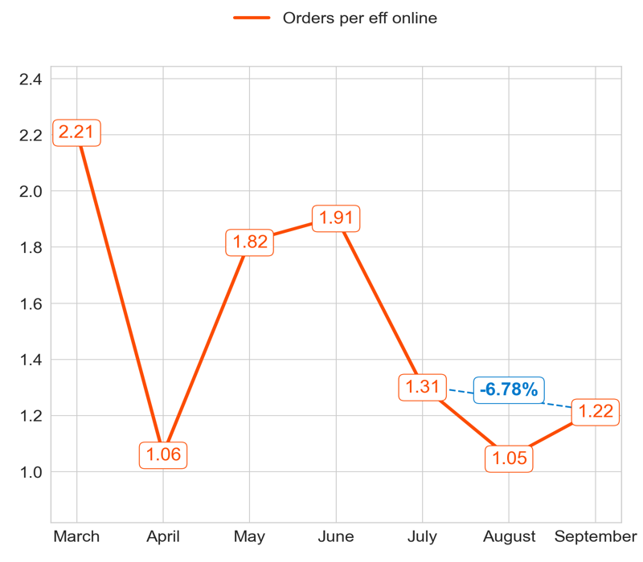
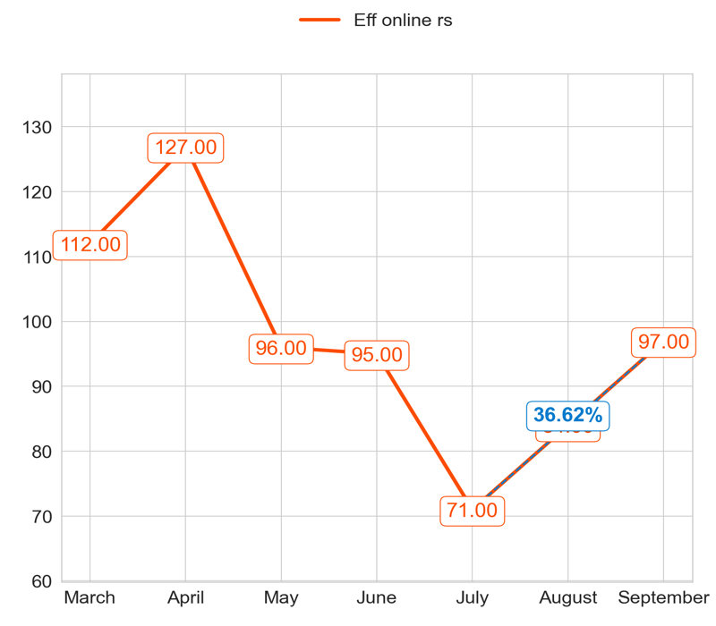
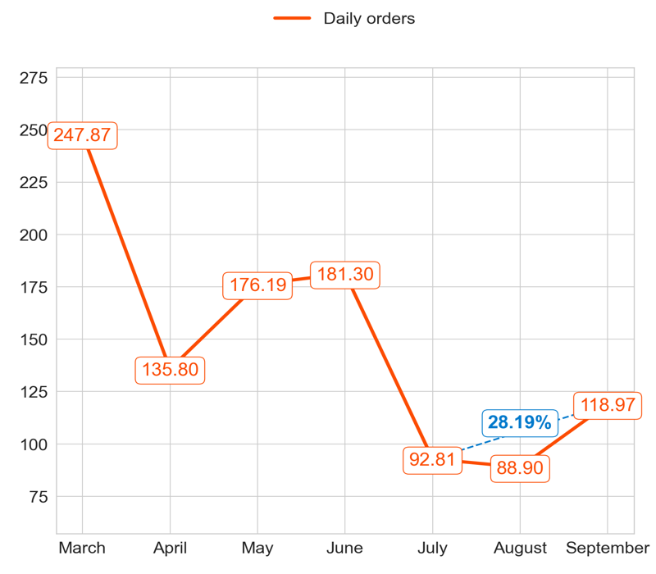
PERFORMANCE
Action Title
Priority 4 -
Comments
Highest: 2.21, Lowest: 1.05
Mean of the last 4 months: 1.39
Highest: 127.00, Lowest: 71.00
Mean of the last 4 months: 95.00
Highest: 247.87, Lowest: 88.90
Mean of the last 4 months: 132.33

Slide 18
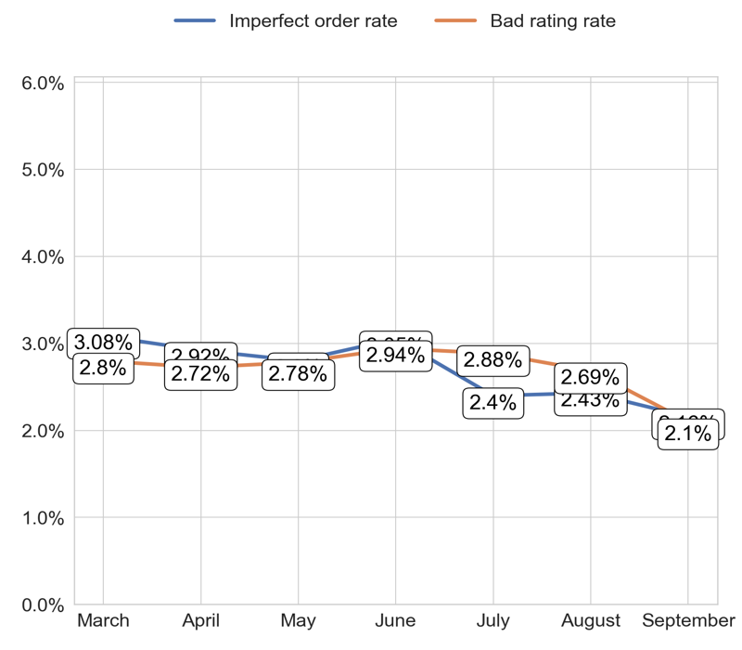


SERVICE
Action Title
Priority 4 -
Comments
Imperfect order rate average in the last 4 months: 2.69 % and the percentage change between the last 2 months: -11.41%.
Bad rating rate average in the last 4 months: 2.7 % and the percentage change between the last 2 months: -20.23%.
No comments
No comments

Slide 19


PERFORMANCE
Action Title
Country overview -
Comments
Last Month Data:
New Rs: 56.37, Priority 1: 1,433.60, Priority 2: 617.30, Priority 3: 87.23, Priority 4: 118.97, Priority 5: 134.80
Last Month percentages:
New Rs: 2.3%, Priority 1: 58.56%, Priority 2: 25.21%, Priority 3: 3.56%, Priority 4: 4.86%, Priority 5: 5.51%

Slide 20


PERFORMANCE
Action Title
Country overview -
Comments
Last Month Data:
New Rs: 33.00, Priority 1: 143.00, Priority 2: 255.00, Priority 3: 78.00, Priority 4: 97.00, Priority 5: 524.00
Last Month percentages:
New Rs: 2.92%, Priority 1: 12.65%, Priority 2: 22.57%, Priority 3: 6.9%, Priority 4: 8.58%, Priority 5: 46.37%

Slide 21




PERFORMANCE
Action Title
Priority 1 -
Comments
Highest: 16.15, Lowest: 12.13
Mean of the last 4 months: 13.58
Highest: 108.00, Lowest: 73.00
Mean of the last 4 months: 92.33
Highest: 1,311.19, Lowest: 1,056.32
Mean of the last 4 months: 1,242.66

Slide 22



SERVICE
Action Title
Priority 1 -
Comments
Imperfect order rate average in the last 4 months: 1.98 % and the percentage change between the last 2 months: -1.6%.
Bad rating rate average in the last 4 months: 2.07 % and the percentage change between the last 2 months: 2.5%.
No comments
No comments

Slide 23



PERFORMANCE
Action Title
Priority 2 -
Comments
Highest: 3.26, Lowest: 2.95
Mean of the last 4 months: 3.14
Highest: 175.00, Lowest: 137.00
Mean of the last 4 months: 166.83
Highest: 554.23, Lowest: 440.35
Mean of the last 4 months: 525.40

Slide 24



SERVICE
Action Title
Priority 2 -
Comments
Imperfect order rate average in the last 4 months: 2.44 % and the percentage change between the last 2 months: -8.31%.
Bad rating rate average in the last 4 months: 2.27 % and the percentage change between the last 2 months: 9.5%.
No comments
No comments

Slide 25



PERFORMANCE
Action Title
Priority 3 -
Comments
Highest: 1.47, Lowest: 0.46
Mean of the last 4 months: 0.81
Highest: 151.00, Lowest: 8.00
Mean of the last 4 months: 118.33
Highest: 120.40, Lowest: 12.97
Mean of the last 4 months: 82.33

Slide 26



SERVICE
Action Title
Priority 3 -
Comments
Imperfect order rate average in the last 4 months: 2.61 % and the percentage change between the last 2 months: 12.34%.
Bad rating rate average in the last 4 months: 2.34 % and the percentage change between the last 2 months: -7.09%.
No comments
No comments

Slide 27



PERFORMANCE
Action Title
Priority 4 -
Comments
Highest: 2.08, Lowest: 1.22
Mean of the last 4 months: 1.58
Highest: 160.00, Lowest: 94.00
Mean of the last 4 months: 136.00
Highest: 305.39, Lowest: 144.32
Mean of the last 4 months: 217.14

Slide 28



SERVICE
Action Title
Priority 4 -
Comments
Imperfect order rate average in the last 4 months: 2.34 % and the percentage change between the last 2 months: -4.29%.
Bad rating rate average in the last 4 months: 2.38 % and the percentage change between the last 2 months: -12.52%.
No comments
No comments

Slide 29


PERFORMANCE
Action Title
Country overview -
Comments
Last Month Data:
New Rs: 73.43, Priority 1: 1,299.33, Priority 2: 554.23, Priority 3: 120.40, Priority 4: 174.43, Priority 5: 107.77
Last Month percentages:
New Rs: 3.15%, Priority 1: 55.77%, Priority 2: 23.79%, Priority 3: 5.17%, Priority 4: 7.49%, Priority 5: 4.63%

Slide 30


PERFORMANCE
Action Title
Country overview -
Comments
Last Month Data:
New Rs: 41.00, Priority 1: 106.00, Priority 2: 175.00, Priority 3: 142.00, Priority 4: 116.00, Priority 5: 340.00
Last Month percentages:
New Rs: 4.46%, Priority 1: 11.52%, Priority 2: 19.02%, Priority 3: 15.43%, Priority 4: 12.61%, Priority 5: 36.96%

